Slide 1

CET203A Digital Electronics
and Logic Design
DEPARTMENT OF COMPUTER SCIENCE AND ENGINEERING

Slide 2

CET203A Digital Electronics and Logic Design
Examination scheme: Total Marks-100
- 50 Marks Continuous Assessment
- 50 Marks End Examination
Course Objectives:
To gain knowledge of characteristics of Logic Families and design Combinational Circuits
To design and implement Sequential Circuits
To realize sequential circuits using concepts of ASM chart.
To design and implement digital circuits using Hardware Description Language.
2

Slide 3
CET203A Digital Electronics and Logic Design
Course Outcomes:
Design sequential circuits using Flip flops and Registers.
Devise applications using ASM chart and concept of Moore, Mealy machine.
Implement combinational and sequential circuits using Integrated Circuits.
Implement combinational and sequential circuits using VHDL program.

Slide 4
Syllabus
Combinational Logic Design: Characteristics of Digital ICs: Speed, power dissipation, figure of merit, fan-in, fan-out, Current and voltage parameters, Noise immunity, operating temperature range. Minimization of SOP and POS equations using K-Maps up to 4 variables. Multiplexers, MUX (IC 74153), MUX tree, De-multiplexers, Decoder (IC74138). Implementation of Half- Adder, Full Adder using MUX and Decoder.
Sequential Logic Design: SR, JK, MS JK, D, T Flip Flops. Truth Tables and Excitation tables. Conversion from one type to another type of Flip Flop. Study of IC7476. Counters: 3 bit up, 3bit down Asynchronous and Synchronous counter. Study of Modulus n counter, IC 7490 and its application to implement MOD Counters. Registers: Buffer register, shift register types-SISO, SIPO, PISO, PIPO. Ring counters, Johnson Counter.
Synchronous Sequential Circuit Design: State diagram, State Tables, State assignment. Moore and Mealy Machine representations, sequence detector using Mealy model. Algorithmic State Machines (ASM): Finite State Machines (FSM). ASM charts, notations, construction of ASM chart (e.g. Counters, sequence detector for Moore and Mealy model).
Introduction to Very High Speed Integrated Circuit Hardware Description Language (VHDL): Introduction to VHDL, Library, Packages, Entity, Architecture, Data Objects (Variables, Signals, and Constants), Data Types, Data Operators and VHDL Modeling styles with Programming Examples – Dataflow, Behavioral and Structural. Comparison of modeling styles. Concurrent Statements (When..Else), Sequential statements (If..Else, Loop) Comparison of Concurrent and Sequential statements.

Slide 5
Syllabus (Contd..)
List of Assignments:
To Realize 3 bit Binary to Gray and 3 bit Gray to Binary code converter using Logic Gates.
Realize following functions using IC 74153
a) Half adder b) 8:1 Mux ( Σ m (0,2,4,7) )
Design and implement 3 bit Synchronous Up Counter using IC7476.
Design and implement MOD 10, MOD 100 and MOD N counter using IC 7490.
Draw ASM chart for real life digital system ( e.g. Washing Machine, Vending Machine, Elevator control, ATM machine).
Design & simulate 4 bit up/down synchronous counter using Behavioral modeling in VHDL.
Design & simulate 4:1 Multiplexer using Dataflow modeling in VHDL.
Design & simulate Full adder using structural modeling in VHDL.

Slide 6
Syllabus (Contd..)
Text Books:
R.P. Jain, “Modern Digital Electronics”, McGraw Hill Education,2012, ISBN–13: 978-0-07- 066911-6., 4th edition
J. Bhaskar , “A VHDL Primer”,: Pearson Education, 2008, ISBN: 9788177582000, 3rd Edition
Reference Books:
Morris Mano, “Digital Logic & Computer Design”, Pearson Education ( Link: https://viden.io/knowledge/114/attachments/427?name=viden-K105-Digital+Logic+And+Computer+Design+By+M.+Morris+Mano+%282nd+Edition%29.pdf)
D. Leach, Malvino, Saha, “Digital Principles and Applications”, Tata McGraw Hill, 2011, ISBN – 13:978-0-07-014170-4. , 7th edition
Thomas Floyd, “Digital Fundamentals”, Pearson Education, 2003, ISBN 8178088762, 8th Edition

Slide 7
Assessment Scheme:
Class Continuous Assessment (CCA) (Max marks 50)
Assignments | Mid Term Test | Presentations | PBL Activity/Case study | MCQ | Oral | Attendance
15% | 30% | - | 15% | 20% | - | 20%
10 Marks | 15 Marks | -- | 10 Marks | 10 Marks |  | 5 Marks
Laboratory Continuous Assessment (LCA) (Max marks 50)
Assessment through Rubric (60%) | End term Practical/oral exam (40%)
30 | 20

Slide 8
Syllabus: Module 1
Combinational Logic Design: Characteristics of Digital ICs: Speed, power dissipation, figure of merit, fan-in, fan-out, Current and voltage parameters, Noise immunity, operating temperature range. Minimization of SOP and POS equations using K-Maps up to 4 variables. Multiplexers, MUX (IC 74153), MUX tree, De-multiplexers, Decoder (IC74138). Implementation of Half- Adder, Full Adder using MUX and Decoder.
Course Objectives:
1) To gain knowledge of characteristics of Logic Families.
2) To design Combinational Circuits.
Course Outcomes:
1) Design combinational circuits using gates and MSI ICs.

Slide 9
Combinational Logic Design

Slide 10
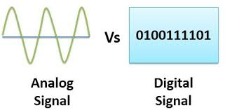
Introduction to Digital Electronics & Logic Design
What is Signal ?
Types of Signal
Analog Signal
Digital Signal

Slide 11
Typical Signal Processing System
ADC
Digital System
DAC
Analog In
Analog Out
Computer
Calculator
Watch
Measuring Instrument

Slide 12
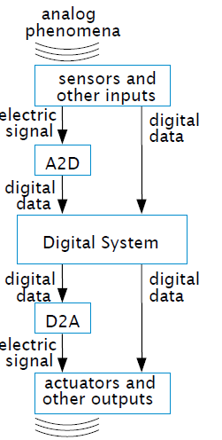
Typical Signal Processing System in Details

Slide 13
Advantages of Digital Systems Over Analog Systems
Reproducibility of the results.
Accuracy of results.
More reliable than analog systems due to better immunity to noise.
Ease of design: No special math skills needed to visualize the behavior of small digital (logic) circuits.
Flexibility and functionality.
Programmability.
Speed: A digital logic element can produce an output in less than 10 nanoseconds (10⁻⁸ seconds).
Economy: Due to the integration of millions of digital logic elements on a single miniature chip forming low cost integrated circuit (ICs).
Uses less Bandwidth.
Efficiency in long distance transmission.

Slide 14
Inside a Digital System
Digital Systems
Modules
Sub modules
Basic Units(Logic Gates)
Circuits( Transistor, resister, Capacitor etc.)

Slide 15
Boolean Logic Gates (Building Blocks for Digital Circuits ) (Because Switches are Hard to Work With)
“Logic gates” are better digital circuit building blocks than switches (transistors), Why?...

Slide 16
Integrated Circuits
The building blocks of computers
Designed for specialized functions
Examples: the CPU, bus interface, memory management unit
Transistors: primary components of ICs
Motorola MPC 7400 PowerPC modules: 6.5 million transistors in less than ½ in²

Slide 17
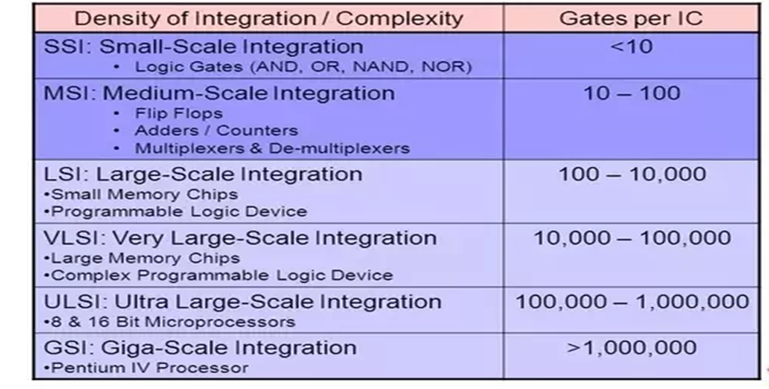
Integrated Circuits
An IC is nothing but - a number of logic gates fabricated on a single silicon chip.
ICs can be classified according to how many gates they contain
SSI, MSI, LSI, VLSI, ULSI, GSI

Slide 18
SOP & POS

Slide 19
Standard Representations for Logic Functions
Logic functions are expressed in terms of logical variables.
Logic function and logic circuit are used synonymously.
A logic circuit is a circuit that executes a processing or controlling function in a computer. This circuit implements logical operations on information to process it.
Logic circuit utilize two values for a given physical quantity (voltage, for example) to denote the Boolean values true and false or 1 and 0 respectively. Logic circuits have inputs, as well as having outputs which can be dependent on the inputs.

Slide 20
Values of logic variables and logic functions are in binary form( 1 and 0). Any logic function can be expressed in the forms of
1. Sum of Products form (SOP) and
2 Product of Sums form (POS)
E.g. Y= AB + AC’ + BC------------SOP
Y= (A +C)(B + C’)-----------POS

Slide 21
Standard Representations for Logic Functions
Canonical Normal Form
Standard form for Boolean expression that provide a unique signature
If each term in SOP and POS forms contains all the literals then these are known as canonical SOP and POS respectively.
Each individual term in canonical SOP form is called as minterm and in canonical POS form as maxterm.

Slide 22
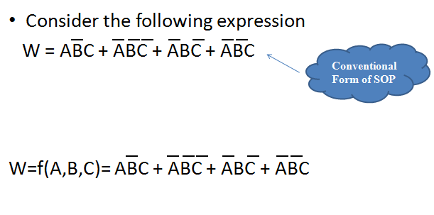
Canonical or Conventional form

Slide 23
Sum of Product (SOP)
It is a Disjunctive Normal form or Minterm Expansion
E.g.
AB + CD
(A AND B) OR (C AND D)
i.e. OR of AND terms

Slide 24
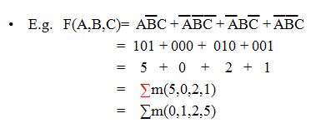
Summation Form
Each individual term in canonical SOP form is called as minterm and in canonical POS form as maxterm.
Summation form is obtained by referring to each minterm in the expression by it’s numerical equivalent in domain, rather than by the list of variables
In this case we substitute a “1” for all positive variables & a “0” for all inverted
All missing variables (i.e. if in AC, B is missing), we have to expand means include all variables, so AC would be ABC + AB’C
Minterms

Slide 25
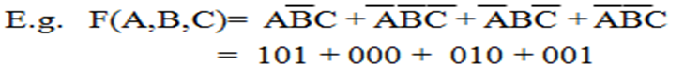
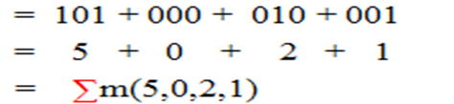
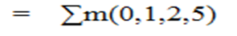
Conversion Process
It takes 3 steps:
Each minterm is converted into it’s binary equivalent.
2. Each minterm is converted from binary to decimal.
3. Finally the min terms are placed in ascending order

Slide 26
Advantages of Summation form
It is useful for implementation in Programmable Logic
One more advantage is that very long & complex expressions can be easily described
Useful for implementation with hardware devices

Slide 27
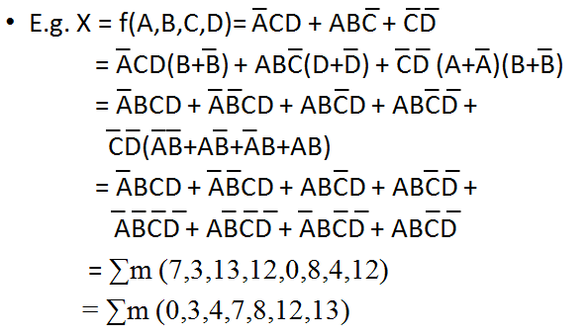
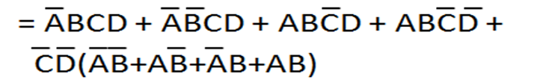
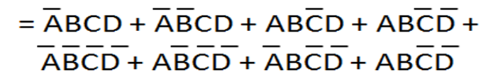
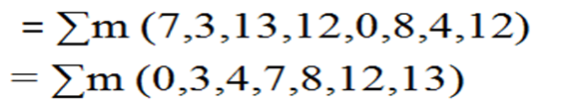
Conversion from Conventional to Summation Form

Slide 28
Conversion from Conventional to Summation Form

Slide 29
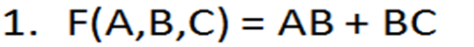
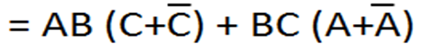
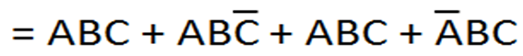
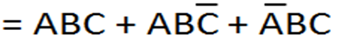
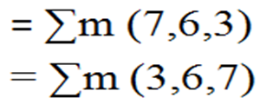
Practice Examples

Slide 30
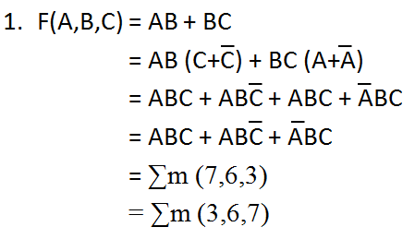
Practice Examples

Slide 31
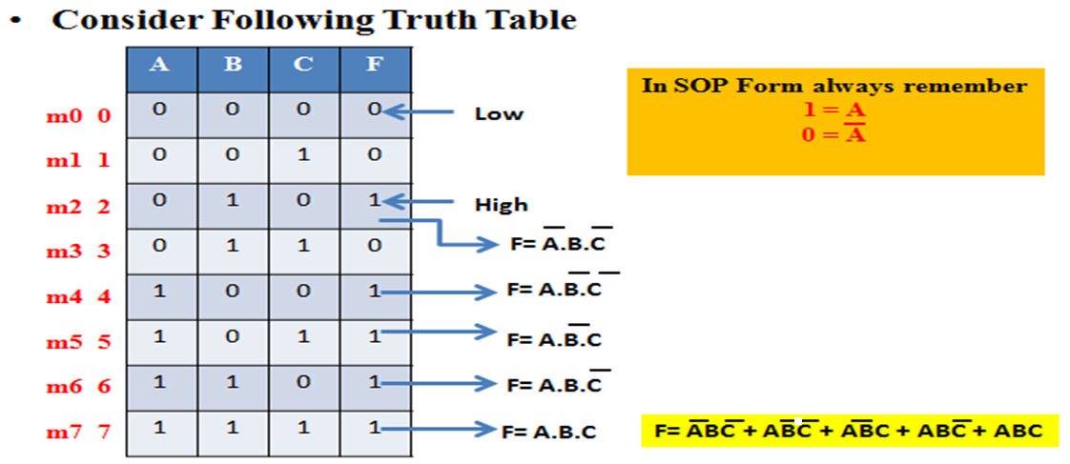

Slide 32
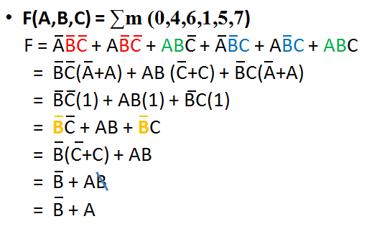
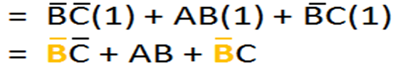
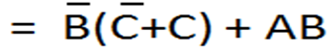
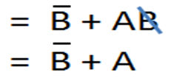
Practice Examples(Contd..)

Slide 33
Practice Examples(Contd..)

Slide 34
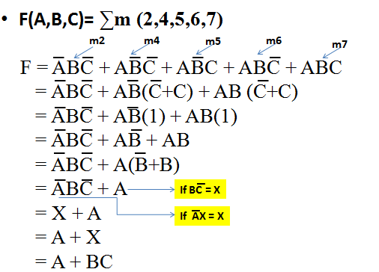
Practice Examples(Contd..)

Slide 35
Practice Examples(Contd..)

Slide 36
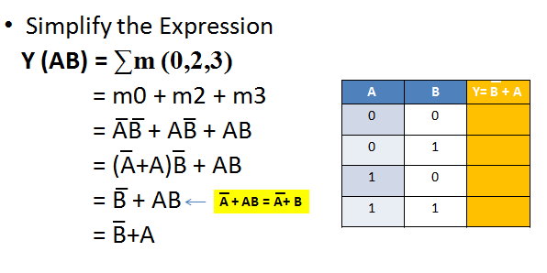
Practice Examples(Contd..)
CSE203 Digital Electronics and Logic Design

Slide 37
Practice Examples(Contd..)
CSE203 Digital Electronics and Logic Design

Slide 38
Product of Sum (POS)
It is a Conjunctive Normal form or Maxterm Expansion
E.g.
(A+B) (C+D)
(A OR B) AND (C OR D)
i.e. AND of OR terms

Slide 39
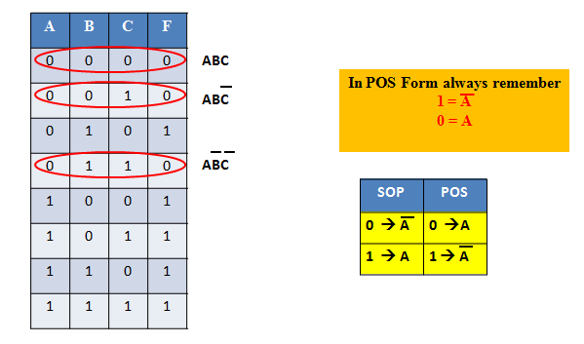
POS Contd..
A+B+C
A+B+C’
A+B’+C’

Slide 40
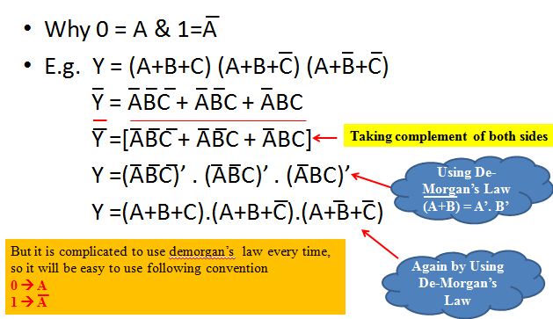
POS (Contd..)

Slide 41
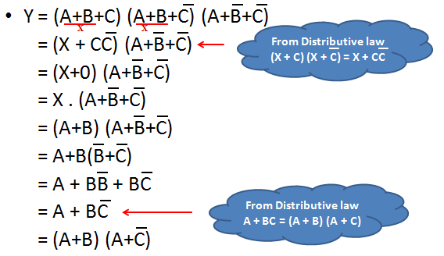
POS (Contd..)

Slide 42
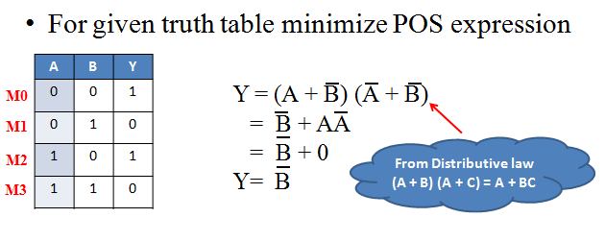
Practice Example

Slide 43
Practice Example

Slide 44
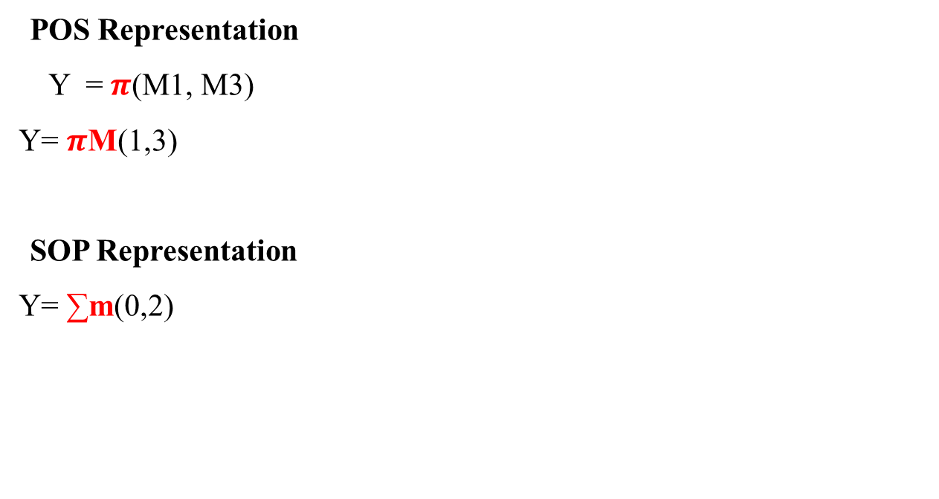
Practice Example (Contd..)
POS Representation
Y = $π$(M1, M3)
Y= $π$M(1,3)
SOP Representation
Y=∑m(0,2)

Slide 45
Practice Example (Contd..)
For following truth table find minterm & maxterm i.e. SOP & POS forms
A | B | C | F
0 | 0 | 0 | 1
0 | 0 | 1 | 0
0 | 1 | 0 | 1
0 | 1 | 1 | 1
1 | 0 | 0 | 0
1 | 0 | 1 | 0
1 | 1 | 0 | 1
1 | 1 | 1 | 1
Y (A,B,C) = ∑m(0,2,3,6,7)
m0 0
M1 1
m2 2
Y (A,B,C) = πM(1,4,5)
m3 3
M4 4
M5 5
m6 6
m7 7

Slide 46
Practice Example (Contd..)
For following truth table find summation & product forms i.e. SOP & POS forms
A | B | C | F
0 | 0 | 0 | 1
0 | 0 | 1 | 0
0 | 1 | 0 | 1
0 | 1 | 1 | 1
1 | 0 | 0 | 0
1 | 0 | 1 | 0
1 | 1 | 0 | 1
1 | 1 | 1 | 1
Y (A,B,C) = ∑m(0,2,3,6,7)
m0 0
M1 1
m2 2
Y (A,B,C) = πM(1,4,5)
m3 3
M4 4
M5 5
m6 6
m7 7

Slide 47
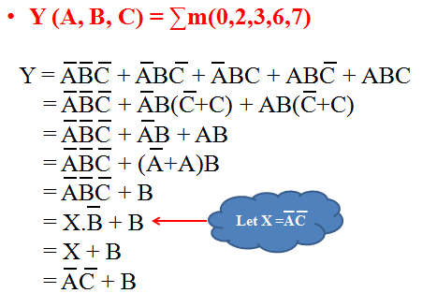
Practice Example (Contd..)

Slide 48
Practice Example (Contd..)

Slide 49
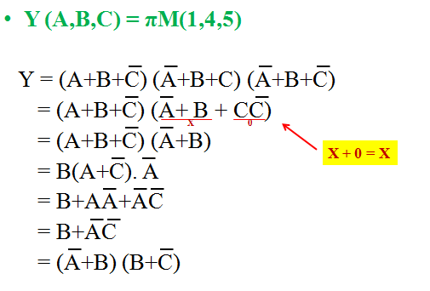
Practice Example (Contd..)

Slide 50
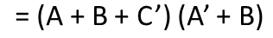
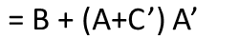
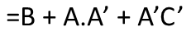
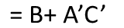
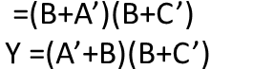
Practice Example (Contd..)
Y(A,B,C) = πM(1,4,5)

Slide 51
K-MAP

Slide 52
Introduction
Sometimes it is difficult to be sure that a logic expression can be simplified.
Solution is K-Map
A Karnaugh map (K-Map) is a pictorial method used to minimize Boolean expression without having to use Boolean algebra theorems & equation manipulation
It is a special version of truth table
Using K-Map, expressions with 2 to 4 variables are easily minimized

Slide 53
Introduction (Contd..)
MSB
LSB
A | B | C | F
0 | 0 | 0 | 0
0 | 0 | 1 | 0
0 | 1 | 0 | 0
0 | 1 | 1 | 1
1 | 0 | 0 | 0
1 | 0 | 1 | 1
1 | 1 | 0 | 1
1 | 1 | 1 | 1
0
1
2
3
4
5
6
7
BC
00
01
11
10
0
0 | 0 | 1 | 0
0 | 1 | 1 | 1
A
1

Slide 54
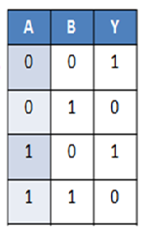
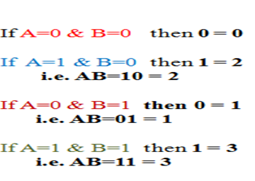
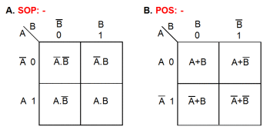
2 – Variables K- Map
0
1
2
3

Slide 55
3 – Variables K- Map
BC
00 01 11 10
A
0
1
0 | 1 | 3 | 2
4 | 5 | 7 | 6
BC
BC
00 01 11 10
00 01 11 10
A
A
0
1
A’B’C’ | A’B’C | A’BC | A’BC’
AB’C’ | AB’C | ABC | ABC’
0
1
A+B+C | A+B+C’ | A+B’+C’ | A+B’+C
A’+B+C | A’+B+C’ | A’+B’+C’ | A’+B’+C
SOP Form
POS Form

Slide 56
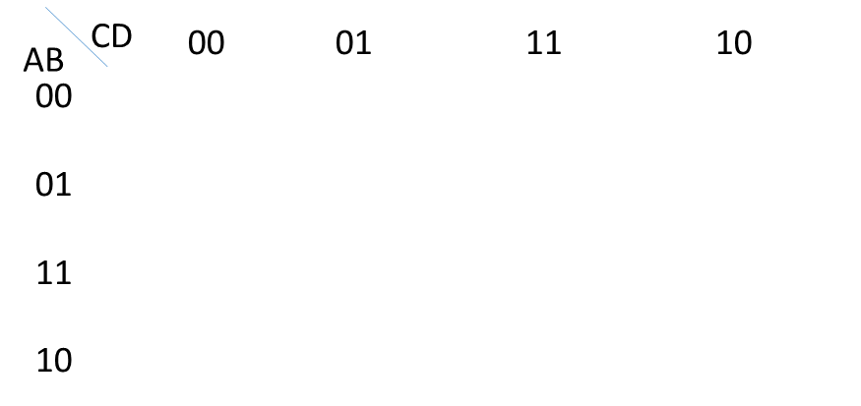
4 – Variables K- Map
CD
00 01 11 10
AB
00
01
11
10
0 | 1 | 3 | 2
4 | 5 | 7 | 6
12 | 13 | 15 | 14
8 | 9 | 11 | 10
CD
00 01 11 10
AB
A’B’C’D’ | A’B’C’D | A’B’CD | A’B’CD’
A’BC’D’ | A’BC’D | A’BCD | A’BCD’
ABC’D’ | ABC’D | ABCD | ABCD’
AB’C’D’ | AB’C’D | AB’CD | AB’CD’
A+B+C+D | A+B+C+D’ | A+B+C’+D’ | A+B+C’+D
A+B’+C+D | A+B’+C+D’ | A+B’+C’+D’ | A+B’+C’+D
A’+B’+C+D | A’+B’+C+D’ | A’+B’+C’+D’ | A’+B’+C’+D
A’+B+C+D | A’+B+C+D’ | A’+B+C’+D’ | A’+B+C’+D
00
01
11
10
SOP Form
POS Form

Slide 57
Practice Examples
Prepare Truth Table for following K - Map
BA
00
01
11
10
DC
00
0 1 | 1 | 3 | 2
4 | 5 1 | 7 1 | 6
12 1 | 13 | 15 1 | 14 1
8 | 9 1 | 11 | 10
01
11
10

Slide 58
Row | D | C | B | A | Y
0 | 0 | 0 | 0 | 0 | 1
1 | 0 | 0 | 0 | 1 | 0
2 | 0 | 0 | 1 | 0 | 0
3 | 0 | 0 | 1 | 1 | 0
4 | 0 | 1 | 0 | 0 | 0
5 | 0 | 1 | 0 | 1 | 1
6 | 0 | 1 | 1 | 0 | 0
7 | 0 | 1 | 1 | 1 | 1
8 | 1 | 0 | 0 | 0 | 0
9 | 1 | 0 | 0 | 1 | 1
10 | 1 | 0 | 1 | 0 | 0
11 | 1 | 0 | 1 | 1 | 0
12 | 1 | 1 | 0 | 0 | 1
13 | 1 | 1 | 0 | 1 | 0
14 | 1 | 1 | 1 | 0 | 1
15 | 1 | 1 | 1 | 1 | 1

Slide 59
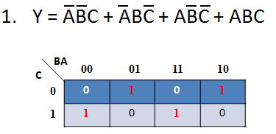
Representation of canonical SOP form on K-Map

Slide 60
Representation of canonical SOP form on K-Map
Y= A’B’C + A’BC’ + AB’C’ +ABC
BC
00 01 11 10
A
0
1
0 | 1 | 0 | 1
1 | 0 | 1 | 0

Slide 61
Representation of canonical SOP form on K-Map (Contd..)
CD
00 01 11 10
AB
00
01
11
10
0 1 | 1 | 3 | 2
4 | 5 1 | 7 1 | 6
12 1 | 13 | 15 1 | 14 1
8 | 9 1 | 11 | 10
Y = A’B’C’D’ + A’BC’D + A’BCD + AB’C’D + ABC’D’ + ABCD+ ABCD’

Slide 62
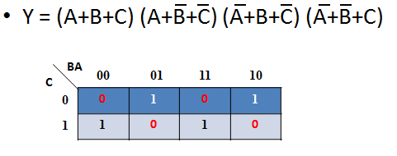
Representation of canonical POS form on K-Map

Slide 63
Representation of canonical POS form on K-Map (Contd..)
CD
00 01 11 10
AB
00
01
11
10
0 1 | 0 | 3 0 | 2 0
4 0 | 5 1 | 7 1 | 6 0
12 1 | 13 0 | 15 1 | 14 1
8 0 | 9 1 | 11 0 | 10 0

Slide 64
Representation of canonical POS form on K-Map (Contd..)
CD
00 01 11 10
AB
00
01
11
10
0 1 | 0 | 3 0 | 2 0
4 0 | 5 1 | 7 1 | 6 0
12 1 | 13 0 | 15 1 | 14 1
8 0 | 9 1 | 11 0 | 10 0
Y= (A + B + C + D’) (A + B + C’+D’) (A + B + C’ +D)
(A + B’ + C + D) (A + B’ + C’ + D) (A’ + B’ + C + D’)
(A’ + B + C + D) (A’ + B + C’ + D’) (A’ + B + C ‘+ D)
Y=πM( 1,2,3,4,6,8,10,11,13 )

Slide 65
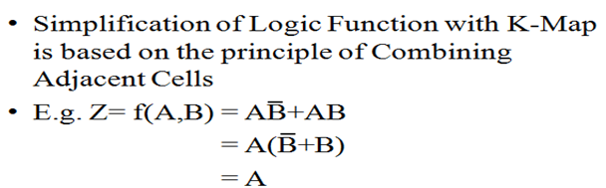
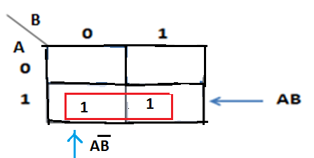
Simplification of Logic function using K-Map

Slide 66
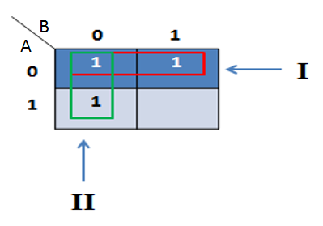
Example

Slide 67
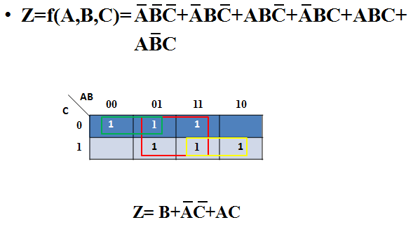
Example (Contd..)

Slide 68
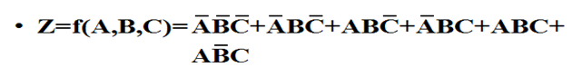
Example (Contd..)
BC
00
01
11
10
A
0
1 |  | 1 | 1
 | 1 | 1 | 1
1
Z = A’C’ + AC + B

Slide 69
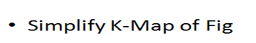
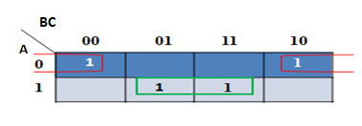
Example (Contd..)

Slide 70
Example (Contd..)
Y = A’C’ + AC

Slide 71
Four Adjacent ones
AB
CD
00
01
11
10
00
0 1 | 4 | 12 | 8 1
1 1 | 5 | 13 | 9 1
3 1 | 7 1 | 15 1 | 11 1
2 | 6 | 14 | 10
01
11
10

Slide 72

Four Adjacent ones (Contd..)
AB
CD
00
01
11
10
00
0 1 | 4 | 12 | 8 1
1 1 | 5 | 13 | 9 1
3 1 | 7 1 | 15 1 | 11 1
2 | 6 | 14 | 10
01
11
10
Y = B’C’ + CD

Slide 73

Four Adjacent ones (Contd..)

Slide 74
Four Adjacent ones (Contd..)

Slide 75

Four Adjacent ones (Contd..)

Slide 76
Four Adjacent ones (Contd..)
= A’B’CD + A’BCD + ABCD + AB’CD
= CD(A’B’ + A’B + AB + AB’)
= CD [ A’ ( B’ + B) + A (B+B’)]
=CD(A’ + A)---------------------------------(A+A’)=1
=CD

Slide 77
Prime Implicant
The process of simplification involves grouping of Minterms & identifying Prime Implicants (PI) & Essential Prime Implicants (EPI)
Prime implicant is a group of ones (minterms) that cannot be combined with any other ones (minterms) or groups
EPI is PI, in which one or more minterms are unique
i.e. it contain atleast one minterm which is not contained in any other PI

Slide 78
Prime Implicant (Contd..)
AB
C
00
01
11
10
0
1
1 |  | 1
1
BA
DC
00
01
11
10
00
 |  | 1 | 1
1 |  |  | 1
 |  | 1 | 1
 |  |  | 1
Prime Implicant
01
11
10

Slide 79

K-Map of 4 - variable

Slide 80

Minimization of SOP Form

Slide 81
Minimization of SOP Form
A | B | C | D | Y
0 | 0 | 0 | 0 | 1
0 | 0 | 0 | 1 | 1
0 | 0 | 1 | 0 | 1
0 | 0 | 1 | 1 | 1
0 | 1 | 0 | 0 | 0
0 | 1 | 0 | 1 | 0
0 | 1 | 1 | 0 | 0
0 | 1 | 1 | 1 | 1
1 | 0 | 0 | 0 | 1
1 | 0 | 0 | 1 | 1
1 | 0 | 1 | 0 | 1
1 | 0 | 1 | 1 | 1
1 | 1 | 0 | 0 | 1
1 | 1 | 0 | 1 | 1
1 | 1 | 1 | 0 | 0
1 | 1 | 1 | 1 | 0
Determine the minimized expression in SOP form for the given truth table -

Slide 82

Minimization of SOP Form (Contd..)

Slide 83

Minimization of POS Form

Slide 84
Minimization of POS Form
A | B | C | D | Y
0 | 0 | 0 | 0 | 1
0 | 0 | 0 | 1 | 1
0 | 0 | 1 | 0 | 1
0 | 0 | 1 | 1 | 1
0 | 1 | 0 | 0 | 0
0 | 1 | 0 | 1 | 0
0 | 1 | 1 | 0 | 0
0 | 1 | 1 | 1 | 1
1 | 0 | 0 | 0 | 1
1 | 0 | 0 | 1 | 1
1 | 0 | 1 | 0 | 1
1 | 0 | 1 | 1 | 1
1 | 1 | 0 | 0 | 1
1 | 1 | 0 | 1 | 1
1 | 1 | 1 | 0 | 0
1 | 1 | 1 | 1 | 0
Minimize given truth table using Maxterm

Slide 85

Minimization of POS Form (Contd..)

Slide 86
Don’t Care Condition (X)
The K-Maps are simplified using either 1’s or 0’s, therefore we make the entries in the map for either 0 or 1
The cell which do not contain 1 are assumed to contain 0 & vice versa
This is not always true, since there are cases in which certain combinations of I/P variables do not matter

Slide 87
Don’t Care Condition (X)
In such a situation the designer has a flexibility & it is left to him whether to assume 0 or 1 as O/P for each of these combinations
This condition is known as Don’t Care Condition and can be represented on K-Map as a X mark in the corresponding cell
The X mark in a cell may be assumed to be a 1 or 0 depending upon which one leads to a simpler expression

Slide 88

Don’t Care Condition (X)
Without Considering don’t care conditions.
Y= AB’C
Assuming don’t care as 1.
Y=AC
POS form: Assuming don’t care as 0.
Y = A .C’

Slide 89

Example

Slide 90
Example
CD
00 01 11 10
AB
A’D + CD

Slide 91

Example (Contd..)

Slide 92

Example (Contd..)
Y = (A + B’) (A’ + C + D)

Slide 93
BCD to Excess-3 Code conversion
B.C.D |  |  |  | Excess-3
B3 | B2 | B1 | B0 | X3 | X2 | X1 | X0
0 | 0 | 0 | 0 | 0 | 0 | 1 | 1
0 | 0 | 0 | 1 | 0 | 1 | 0 | 0
0 | 0 | 1 | 0 | 0 | 1 | 0 | 1
0 | 0 | 1 | 1 | 0 | 1 | 1 | 0
0 | 1 | 0 | 0 | 0 | 1 | 1 | 1
0 | 1 | 0 | 1 | 1 | 0 | 0 | 0
0 | 1 | 1 | 0 | 1 | 0 | 0 | 1
0 | 1 | 1 | 1 | 1 | 0 | 1 | 0
1 | 0 | 0 | 0 | 1 | 0 | 1 | 1
1 | 0 | 0 | 1 | 1 | 1 | 0 | 0
1 | 0 | 1 | 0 | X | X | X | X
1 | 0 | 1 | 1 | X | X | X | X
1 | 1 | 0 | 0 | X | X | X | X
1 | 1 | 0 | 1 | X | X | X | X
1 | 1 | 1 | 0 | X | X | X | X
1 | 1 | 1 | 1 | X | X | X | X

Slide 94
B1B0 B3B2 | 00 | 01 | 11 | 10
00 | 0 | 0 | 0 | 0
01 | 0 | 1 | 1 | 1
11 | X | X | X | X
10 | 1 | 1 | X | X
B1B0 B3B2 | 00 | 01 | 11 | 10
00 | 0 | 1 | 1 | 1
01 | 1 | 0 | 0 | 0
11 | X | X | X | X
10 | 0 | 1 | X | X
X3 =B3+B2 (B0+B1)
_ _ _ _
X2=B2B1B0 +B2B0 +B2B1
B1B0 B3B2 | 00 | 01 | 11 | 10
00 | 1 | 0 | 1 | 0
01 | 1 | 0 | 1 | 0
11 | X | X | X | X
10 | 1 | 0 | X | X
B1B0 B3B2 | 00 | 01 | 11 | 10
00 | 1 | 0 | 0 | 1
01 | 1 | 0 | 0 | 1
11 | X | X | X | X
10 | 1 | 0 | X | X
_ _
X1= B0B1 +B0B1
_
X0= B0

Slide 95
Multiplexer and Demultiplexer

Slide 96

Multiplexer
Data Selector or Many to one circuit
Single IC

Slide 97
Multiplexer
Types
2:1 MUX
4:1 MUX
8:1 MUX
16:1 MUX
(74157 / 74158 – Inverted I/P)
(74153 / 74352 – Inverted I/P)
(74151 / 74152 – Inverted I/P)
(74150 – Inverted I/P)
97

Slide 98
Multiplexer
Advantages of Mux
Reduces the number of wires
Reduces circuit complexity & cost
Minimize the IC package count
98

Slide 99

2:1 Multiplexer

Slide 100

2:1 Multiplexer Circuit

Slide 101
2:1 Multiplexer Circuit
Draw Gate level circuit diagram of 2:1 Multiplexer.

Slide 102


4:1 Multiplexer
Inputs |  |  | Output
E | S1 | S0 | Y
0 | X | X | 0
1 | 0 | 0 | I0
1 | 0 | 1 | I1
1 | 1 | 0 | I2
1 | 1 | 1 | I3
102

Slide 103
4:1 Multiplexer
Draw circuit diagram for 4:1 multiplexer using gates.
103

Slide 104

Implement Circuit using MUX

Slide 105
Implement Circuit using MUX

Slide 106

IC 74153
Strobe (G’) Active Low | Select Inputs |  | Data Inputs |  |  |  | Y
 | B | A | D0 | D1 | D2 | D3
H | X | X | X | X | X | X | L
L | L | L | L | X | X | X | L
L | L | L | H | X | X | X | H
L | L | H | X | L | X | X | L
L | L | H | X | H | X | X | H
L | H | L | X | X | L | X | L
L | H | L | X | X | H | X | H
L | H | H | X | X | X | L | L
L | H | H | X | X | X | H | H
(B)
(A)

Slide 107
Multiplexer Tree
16-to-l multiplexers are the largest available lCs
To meet the larger input needs, multiplexers stack or trees are designed with the help of enable/strobe inputs.

Slide 108

MUX Tree
Implement 4:1 Using 2:1

Slide 109

MUX Tree (Contd..)
Implement 8:1 Multiplexer using 4:1 and 2:1 Multiplexer.
9

Slide 110
Truth Table
S2 | S1 | S0 | Y
0 | 0 | 0 | I0
0 | 0 | 1 | I1
0 | 1 | 0 | I2
0 | 1 | 1 | I3
1 | 0 | 0 | I4
1 | 0 | 1 | I5
1 | 1 | 0 | I6
1 | 1 | 1 | I7
10

Slide 111

Demultiplexer
11

Slide 112

Demultiplexer
This circuit can also be used as binary-to-decimal decoder.
Binary inputs applied at the select input lines and the output will be obtained on the corresponding output line.
The data input line is to be connected to logic 1 level.

Slide 113
Demultiplexer
This device is available as an MSI IC and can conveniently be used for the design of combinational circuits.
These devices are available as 2line-to-4-line, 3-line-to-8-line, and 4-line-to-I6-line decoders.
The outputs of most of these devices are active-low also there is an active-low enable/data input terminal available.

Slide 114

Demultiplexer

Slide 115

1:2 Demultiplexer
Draw 1:2 Demultiplexer using gates.
12

Slide 116
1:4 Demultiplexer
4:1
DeMux
E | S1 | S0 | D0 | D1 | D2 | D3
0 | X | X | 0 | 0 | 0 | 0
1 | 0 | 0 | I | 0 | 0 | 0
1 | 0 | 1 | 0 | I | 0 | 0
1 | 1 | 0 | 0 | 0 | I | 0
1 | 1 | 1 | 0 | 0 | 0 | I
I | 1: 4 DEMUX
E
D0 D1 D2
D3
S1
S0
13

Slide 117

Implement the Circuit
Draw 1:4 Demultiplexer using gates.
14

Slide 118

Implementation of SOP using MUX
Implementation of 3 variable SOP expression using 8x1 MUX
A | B | C | X
0 | 0 | 0 | 1
0 | 0 | 1 | 0
0 | 1 | 0 | 0
0 | 1 | 1 | 1
1 | 0 | 0 | 1
1 | 0 | 1 | 0
1 | 1 | 0 | 1
1 | 1 | 1 | 0

Slide 119

Implementation of 3 variable SOP expression using 4x1 MUX (Reduction Method)
F(A,B,C,D) = X = Ʃ m(0, 3, 4, 6)
As only 2 select lines are available for 4:1 mux, there is a question of connection of one variable.
Lets connect B and C variables to S1 and S0 select lines of multiplexer.
Use reduction method to find where should third variable A should be connected.
17

Slide 120


Implementation of 3 variable SOP expression using 4x1 MUX (Reduction Method)
I0 = Vcc, I1 = Gnd
I2 = A, I3 = A’

Slide 121


Implementation of 4 variable SOP expression using 8x1 MUX (Reduction Method)
F(A,B,C,D) = X = Ʃ m(0, 2, 3, 8, 9, 10, 15)
18

Slide 122
Decoder

Slide 123
Decoder
A decoder is a logic circuit that accepts a set of inputs that represents a binary number and activates only the output that corresponds to the input number
In other words, a decoder circuit looks at its inputs, determines which binary number is present there, and activates the one output that corresponds to that number ; all other outputs remain inactive
In its general form, a decoder has N input lines to handle N bits and form one to 2 ^{N} output lines to indicate the presence of one or more N-bit combinations.
The basic binary function
An AND gate can be used as the basic decoding element because it produces a
HIGH output only when all inputs are HIGH

Slide 124

General Decoder Diagram
# There are 2^{N} possible input combinations, from A₀ to A_{N−1}.
For each of these input combinations only one of the M outputs will be active HIGH (1), all the other outputs are LOW (0).

Slide 125
General Decoder Diagram (Contd..)
If an active-LOW output (74138, one of the output will low and the rest will be high) is required for each decoded number, the entire decoder can be implemented with
NAND gates
Inverters
If an active-HIGH output (74139, one of the output will high and the rest will be low) is required for each decoded number, the entire decoder can be implemented with
AND gates
Inverters

Slide 126

2-to-4-Line Decoder (with Enable input)-Active LOW output

Slide 127
2-to-4-Line Decoder (with Enable input)- Active LOW output (Contd..)
The circuit operates with complemented outputs and a complement enable input. The decoder is enabled when E is equal to 0.
Only one output can be equal to 0 at any given time, all other outputs are equal to 1.
The output whose value is equal to 0 represents the minterm selected by inputs A and B
The circuit is disabled when E is equal to 1.

Slide 128



74138 Decoder

Slide 129

4-line-to-16 line Decoder constructed with two 3-line-to-8 line decoders

Slide 130
4-line-to-16 line Decoder constructed with two 3-line-to-8 line decoders (Contd..)
When w=0, the top decoder is enabled and the other is disabled. The bottom decoder outputs are all 0’s , and the top eight outputs generate min-terms 0000 to 0111.
When w=1, the enable conditions are reversed. The bottom decoder outputs generate min-terms 1000 to 1111, while the outputs of the top decoder are all 0’s

Slide 131
Half Adder & Full Adder
1

Slide 132

Half Adder

Slide 133

Half Adder Truth Table

Slide 134

Circuit Diagram

Slide 135



Half Adder USING 4:1 MUX :

Slide 136

Full Adder

Slide 137

Full Adder Truth Table

Slide 138


Full Adder Circuit (Sum & Carry)

Slide 139

Full Adder Circuit (Sum & Carry)

Slide 140
Full Adder using Decoder
Let x, y and z represent these three bits. Sum and Carry outputs of a full adder have the following truth tables-
X | Y | Z | S | C
0 | 0 | 0 | 0 | 0
0 | 0 | 1 | 1 | 0
0 | 1 | 0 | 1 | 0
0 | 1 | 1 | 0 | 1
1 | 0 | 0 | 1 | 0
1 | 0 | 1 | 0 | 1
1 | 1 | 0 | 0 | 1
1 | 1 | 1 | 1 | 1

Slide 141



Full Adder using Decoder
Let x, y and z represent these three bits. Sum and Carry outputs of a full adder can be given as:
Assumption: Active high output decoder

Slide 142
Logic Families
What is logic families?
It is a group of compatible ICs with the same logic levels & supply voltages for performing various logic functions have been fabricated using a specific circuit configuration
Significance of logic families
First and most important is simplicity in design
It reduces the complexity in design
Provide compatibility in digital circuit
Easy to expand

Slide 143
Characteristics of Digital IC
Speed of Operation
Power Dissipation
Figure of Merit
Fan-out
Fan-in
Current & Voltage Parameter
Noise Immunity
Operating Temperature Range
Power Supply Requirements

Slide 144
Speed of Operation (Propagation Delay)
The speed of digital circuit is specified in terms of the propagation delay time
50%
I/P
tpHL
tpLH
O/P
50%
Fig: I/O Voltage waveforms to define Propagation Delay Times

Slide 145
Speed of Operation (Propagation Delay) (Contd..)
The delay times are measured between the 50% voltage levels of I/O waveform
There are 2 delay times
tpHL: O/P goes from the high state to low state
tpLH: O/P making transition from low to high state
The propagation delay time(tp) of logic gate is taken as the average of these 2 delay times
tpHL + tpLH
tp =
2

Slide 146
Power Dissipation
This is the amount of power dissipated in an IC
It is a measure of power consumed by the gate when fully driven by all its inputs
It is wastage of power across the circuit components.
It should be as low as possible.
It is measured in milliwatts
It is determined by current Icc that it draws from the Vcc supply
Power Dissipation (mW) = Vcc X Icc

Slide 147
Power Dissipation (Contd..)
It is related to the power requirement of logic gate
Power dissipation is proportional to the heat generated by the system
Excessive heat dissipation may increase operating temperature & cause gate circuitry to drift out of its normal operating range

Slide 148
Figure of Merit
The figure of merit of a digital IC is defined as the product of speed and power
The speed is specified in terms of a propagation delay time expressed in nanoseconds
Speed power product should be low
Figure of Merit = Propagation Delay X Power
pJ = ns X mW
ns – nano seconds
mW – milliwatts
pJ – pico joules

Slide 149
Figure of Merit (Contd..)
For Example:
An IC has an average propagation delay of 20 ns & an average power dissipation of 5 mW
pJ = ns X mW
pJ = 20 X 5
pJ = 100

Slide 150
Fan Out
This is the number of similar gates which can be driven by a gate
High fan out is advantageous because it reduces the need for additional drivers to drive more gates
The maximum fan out of an O/P, measures its load driving capability
The delay offered by a gate increases with increase in fan out
Fan In
It is total no. of inputs connected to any gate.
Two input gate – Fan in =2
Four input gate – Fan in =4

Slide 151
Current & Voltage Parameter
High Level I/P Voltage (VIH):
This is the minimum I/P voltage which is recognized by the gate as logic 1
Low Level I/P Voltage (VIL):
This is the maximum I/P voltage which is recognized by the gate as logic 0
High Level O/P Voltage (VOH):
This is the minimum voltage available at o/p corresponding to logic1
Low Level O/P Voltage (VOL):
This is the maximum voltage available at o/p corresponding to logic 0

Slide 152
Current & Voltage Parameter (Contd..)
High Level I/P Current (IIH):
This is the minimum current which must be supplied by a driving source corresponding to 1 level voltage
Low Level I/P Current (IIL):
This is the minimum current which must be supplied by a driving source corresponding to 0 level voltage
High Level O/P Current (IOH):
This is the maximum current which the gate can sink in 1 level
Low Level O/P Current (IOL):
This is the maximum current which the gate can sink in 0 level

Slide 153
Current & Voltage Parameter (Contd..)
High Level Supply Current (Icc (1)):
This is the supply current when the o/p of the gate is at logic 1 level
Low Level Supply Current (ICC (0)):
This is the supply current when the o/p of the gate is at logic 0 level
IIL
IOL
IIH
IOH
Fig. Gate with current direction marked

Slide 154
Noise Immunity
The circuit’s ability to tolerate noise signals is referred to as the noise immunity
It is the maximum noise voltage added to an i/p signal of a digital ckt that does not cause an undesirable change in ckt o/p
It is expressed in volts
Noise signals may cause the voltage at the i/p to a logic ckt to drop below VIH or rise above VIL & may produce undesired operation
A quantitative measure of noise immunity is called as a noise margin

Slide 155
Noise Immunity (Contd..)
VoH (Min)
Logic 1
Disallowed o/p voltage range
Logic 1
VIH (Min)
Intermediate I/P
Voltage range
VoL (Max)
Logic 0
VoL (Max)
Logic 0
155

Slide 156
Noise Immunity (Contd..)
VoH
1 State noise margin
VIH
1 = VoH - VIH
VIL
0 State noise margin
0 = VIL - VOL
VoL

Slide 157
Operating Temperature Range
The temperature range in which an IC functions properly must be known
All gates or semiconductor devices are temperature sensitive in nature
The temperature in which the performance of IC is effective is called as operating temperature
Operating temperature of the IC vary from 0⁰ C to 70⁰C
The accepted temperature ranges are
0 to +70⁰C : for Consumer & Industrial operations
-55⁰C to +125⁰c : for Military purpose

Slide 158
Power Supply Requirements
The supply voltage(s) and the amount of power required by an IC are important characteristics considered to choose the proper power supply.

